Slide 1

Theory Of Demand And Supply
Name:- Mori Grishma V.
Enroll No:-160410116063
Subject:-Economics

Slide 2
Topic Covered
Meaning of demand and supply
Meaning of demand, Graphical representation of demand, Meaning of supply, Graphical representation of supply
Determinants of demand and supply
Law of demand and supply:-Equilibrium, Surplus, Shortage
Case study:-Tax Incidence and Heat of oil

Slide 3
Meaning Of Demand And supply
Market :- Buyers,Sellers
Market are two types:
Organized
Non-Oraganized
Meaning of organized and Non-Organized market

Slide 4
Meaning of demand
Demand quantity is the amount of the goods that buyers are willing and able to purchase. There are many determinants which decides the quantity of demand, but one of the most important factor is price.
Price
Demanded quantities
Law of demand :-The quantity demanded of goods falls when the price of the goods increases.

Slide 5
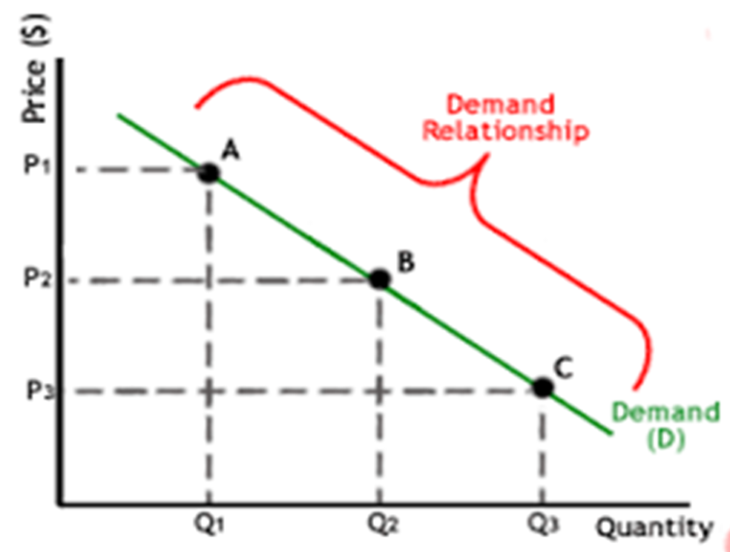
Graphical representation of demand

Slide 6
Meaning of supply
supply quantity is the amount of the goods that sellers are willing and able to sell. There are many determinants which decides the quantity of supply, but one of the most important factor is price.
Price
Supply
Law of supply:-The quantity supplied of goods rises when the price of the goods increases.

Slide 7
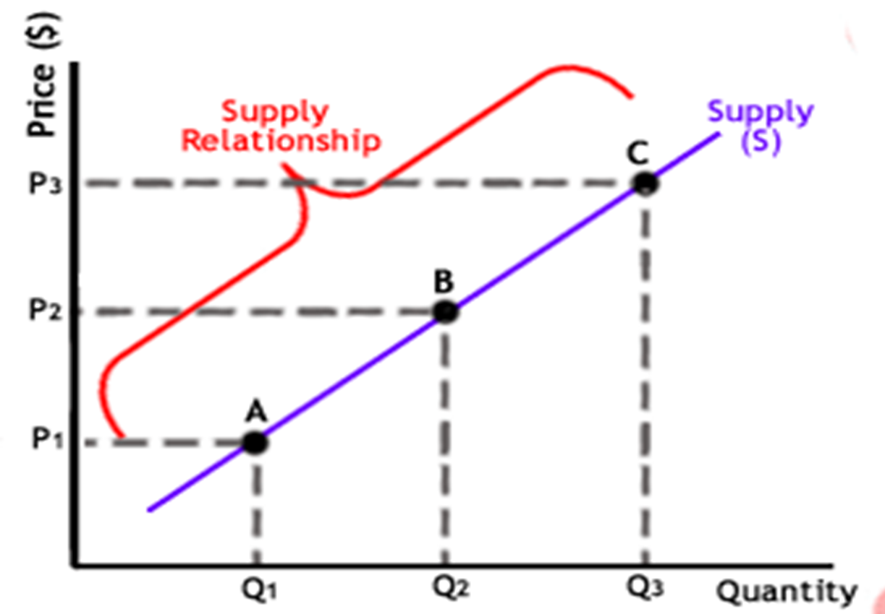
Graphical representation of supply

Slide 8
Determinants of Demand And Supply
A) Determinants of demand :-
1. price 2. Number of buyers 3. Income 4. Future expectations 5. price of relative goods

Slide 9
B) Determinants of supply : 1. Selling price 2. Number of Sellers 3. Price of raw material 4. Future Expectations 5. Technology

Slide 10
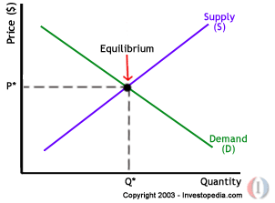
Law of Demand and Supply
If curves of both demand and supply are plotted on the same graph,then both graphs will intersect at one point and this point is termed as equilibrium as shown in the diagram.

Slide 11
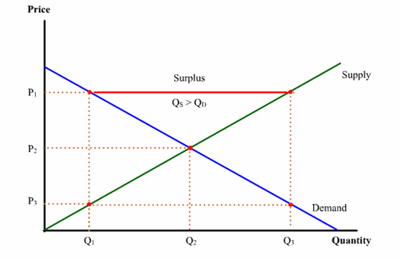
Now,suppose there is market price of goods is above equilibrium price. So the sellers will be motivated to supply more quantity of goods than the quantity demanded. This excess of goods is termed as surplus.

Slide 12
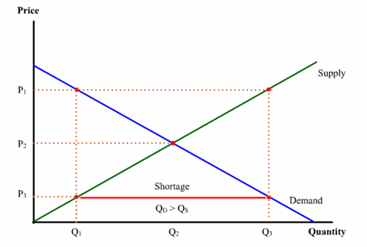
Now,suppose there is market price of goods is below equilibrium price. So, buyer will be motivated to buy more quantity of goods than the quantity demanded. So, the quantity demanded is more than the quantity supplied. This deficiency of goods is termed as shortage.

Slide 13
From both cases, it can be concluded that supply and demand both brings the price in control and attains equilibrium. A law of supply and demand was derived as follows:
“Price of goods adjusts to bring the quantity supplied and The quantity demanded for that good into balance.”

Slide 14
Case Study
TAX INCIDENCE:-
As one example of demand and supply analysis, let us
assume we have a product with the situation shown in
the graph below. The price is $1.00 per unit.

Slide 15
Now a sales tax is imposed. The tax is charged to
the seller. For every $1.00 of sales, assume that
the seller must pay $0.07 to the government.
From the point of view of the seller, this is an additional cost of production. In addition to all other costs, the seller must also pay the sales tax.
we can say that the seller would like to,
raise the price to $1.07. Then, the seller could
pay the $0.07 in tax and still have the same
$1.00 that was earned before the sales tax was
imposed.

Slide 16
However, due to the law of demand, the seller cannot raise the price to $1.07. If the seller raises the price, the quantity demanded will fall.
In this case, equilibrium occurs with the new price at $1.04. At any higher price, there would be a surplus. We say that $0.04 is the incidence of the tax on the buyer because the buyer must pay a $0.04 higher price.
We say that the other $0.03 is the incidence of the tax on the seller because the seller earns $0.03 less that was earned before the sales tax was imposed ($1.04 - $0.07 = $0.97).

Slide 17
EXAMPLE:
The heat of oil was strongly felt as the
oil prices reached $50 per barrel in early 2005
from$10 per barrel in 1998.
The prices were driven by the surge in demand
in countries that included US, India and China
and also the supply factors that had failed to
meet the rise in demand.

Slide 18
THANK YOU

